Slide 1
Science with CEBAF in the 6 GeV Era
L. Cardman
Thomas Jefferson National Accelerator Facility and
University of Virginia

Slide 2
CEBAF@ 6 GeV Has Been an
Unqualified Success. Why?

Slide 3
CEBAF@ 6 GeV Has Been an
Unqualified Success. Why?
CEBAF and its experimental equipment provided a new research tool with dramatically expanded “reach” over its predecessors
Our International User community and strong laboratory staff (expt. and theory) has been innovative and committed to exploiting CEBAF to the fullest extent possible
The Accelerator/Engineering and Physics teams have worked tirelessly to deliver the beam and equipment needed and to enhance our capabilities as the science program needs evolved
We have enjoyed strong support from DOE for running the facility and from DOE, NSF and many other agencies around the world supporting the user community and its activities here
A remarkable cadre of graduate students and postdocs
Thoughtful advice on the science program from our PACs, the theory group, reviews, and many others over the years

Slide 4
CEBAF@ 6 GeV Has Been an
Unqualified Success. Why?
CEBAF and its experimental equipment provided a new research tool with dramatically expanded “reach” over its predecessors
Our International User community and strong laboratory staff (expt. and theory) has been innovative and committed to exploiting CEBAF to the fullest extent possible
The Accelerator/Engineering and Physics teams have worked tirelessly to deliver the beam and equipment needed and to enhance our capabilities as the science program needs evolved
We have enjoyed strong support from DOE for running the facility and from DOE, NSF and many other agencies around the world supporting the user community and its activities here
A remarkable cadre of graduate students and postdocs
Thoughtful advice on the science program from our PACs, the theory group, reviews, and many others over the years

Slide 5
This Success Also Owes a Great Deal to Some Early Decisions
4 GeV vs 2 GeV (Barnes Panel) and Upgradable (Bromley Panel) (both with a lot of community input)
  Access to DIS regime, increased kinematic reach, higher excitation (and form factors) in N* physics, higher counting rates at moderate Q², …..
  Evolved from 4 → 6 GeV simply and has permitted the upgrade to 12 GeV to be undertaken at a very small fraction of the cost of a 12 GeV accelerator
The switch from the original linac-stretcher ring design to the SRF recyclotron we have today (HG).
  Superb beam quality, supported parity experiments, multiple energies simultaneously w/ large dynamic range and no sacrifice in beam quality, ,,,,,,,,,
The inclusion of a third hall w/ the CLAS detector, resisting pressure for only 2 halls (HG), and
The addition of polarized electrons to the arsenal (JDW)

Slide 6
The Science Goals Were Defined from the mid-1970’s through 1982
The NRC Friedlander Panel (1975)
The DOE/NSF Livingston Panel (1977)
The 1979 NUSAC (now NSAC) Long Range Plan
(the first formal NSAC Long Range Plan) – H. Feshbach, chair.
The “Blue Book” (1981)

Slide 7
Then Finalized by the Barnes Panel of NSAC in 1982
Single nucleon structure
Deuteron and few body form factors and inelastic processes
Production of vector mesons and baryons
Discrete states and giant resonances in complex nuclei
Δ and N* production in nuclei
Single nucleon hole states in complex nuclei
Hypernuclei
Deep inelastic scattering on complex nuclei
Fundamental symmetries

Slide 8
Which Also Recommended the Machine Characteristics Needed to Realize that Science
Recommendation: The Subcommittee strongly recommends the construction of a variable energy electron beam facility capable of operation at both high intensity and high duty factor and able to achieve an electron energy of about 4 GeV for the purpose of making coincidence measurements on nuclear targets at large excitation energy and momentum transfer

Slide 9
So Looking Back at the past 30 Years:
How Well Have We Succeeded In Realizing Those Initial Science Goals?
Review them by broad physics topic:
  QCD and the Structure of Hadrons
  Nuclei: From Structure to Exploding Stars
  In Search of the New Standard Model
  Given the time, only a few examples in each area are possible – I’ve picked ones I particularly liked, with an emphasis on experiments that were made feasible by the unique capabilities of the accelerator and its experimental equipment

Slide 10
So Looking Back at the past 30 Years:
How Well Have We Succeeded In Realizing Those Initial Science Goals?
Review them by broad physics topic:
  QCD and the Structure of Hadrons
  Nuclei: From Structure to Exploding Stars
  In Search of the New Standard Model
  Given the time, only a few examples in each area are possible – I’ve picked ones I particularly liked, with an emphasis on experiments that were made feasible by the unique capabilities of the accelerator and its experimental equipment

Slide 11
JLab data on the EM form factors provide a testing ground for theories constructing nucleons from quarks and glue
Before JLab and Recent non-JLab Data
S. Riordan

Slide 12
JLab data on the EM form factors provide a testing ground for theories constructing nucleons from quarks and glue
Today, with Available JLab Data
S. Riordan

Slide 13
JLab data on the EM form factors provide a testing ground for theories constructing nucleons from quarks and glue
Today, with Available JLab Data, Compared w/ Theory
Inferences to date:
Relativity essential
Pion cloud makes critical contributions
Quark Angular Momentum important
……..
Inferences to date:
Relativity essential
Pion cloud makes critical contributions
Quark Angular Momentum important
……..
S. Riordan

Slide 14
JLab data on the EM form factors provide a testing ground for theories constructing nucleons from quarks and glue
Today, with Available JLab Data, Compared w/ Theory
Inferences to date:
Relativity essential
Pion cloud makes critical contributions
Quark Angular Momentum important
……..
Contributions from:
Beam Energy
Polarized Electrons
Innovative Target Designs
Major New Ancillary Equipment
CLAS (and HRS and HMS) Detectors
S. Riordan

Slide 15
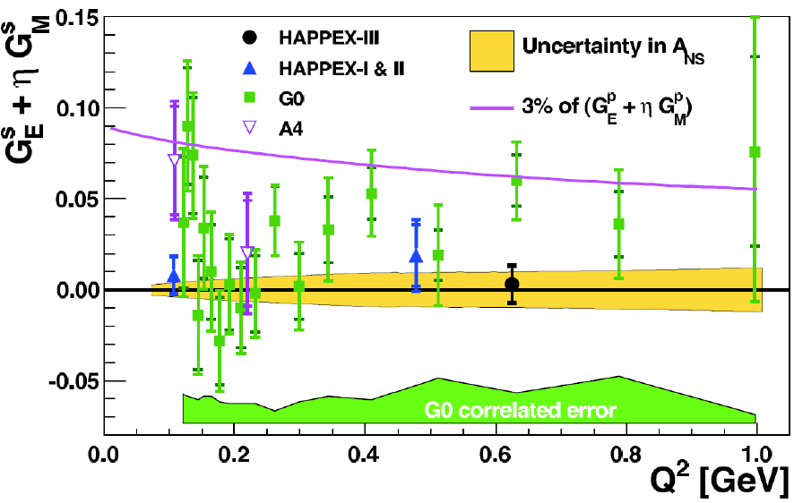
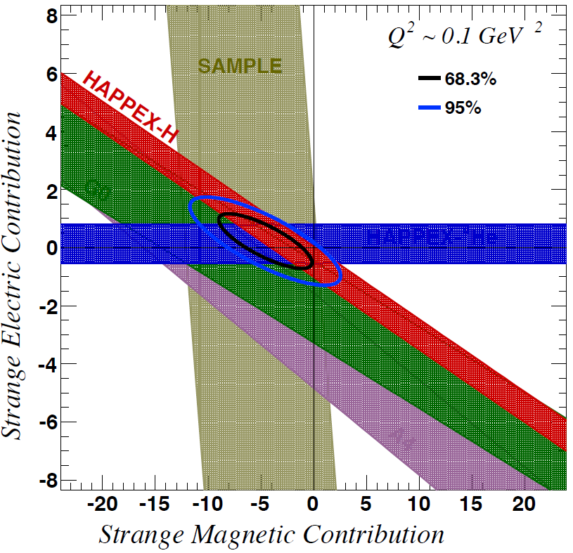
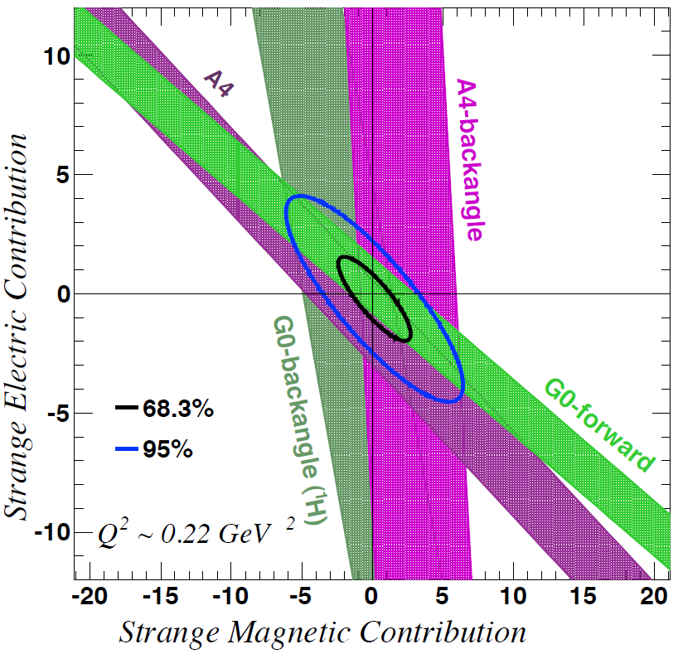
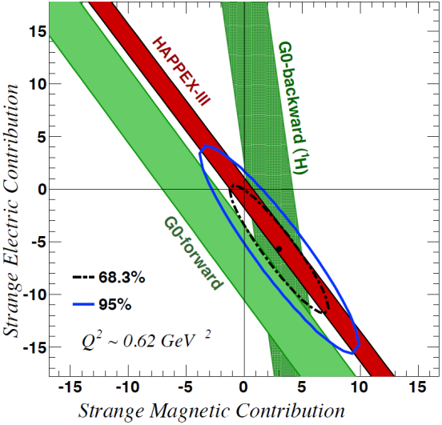
Strangeness Contribution to Nucleon Form Factors
HAPPEx-3: PRL 108 (2012) 102001
G0-Backward: PRL 104 (2010) 012001
Purple line represents 3% of the proton form factors
→ strange quarks do not play a substantial role in the long-range electromagnetic structure of nucleons
Contributions from:
Beam Energy
Polarized Electrons
Accelerator Beam Quality
Innovative Target Designs
Major New Ancillary Equipment
Major, One-up Experiments (G0)
Idea from R. D. McKeown, Phys. Lett. B219, 140 (1989), and
D. H. Beck, Phys. Rev. D39, 3248 (1989).

Slide 16
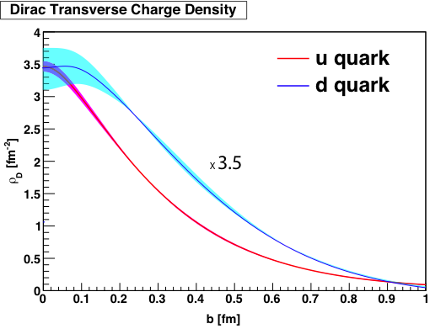
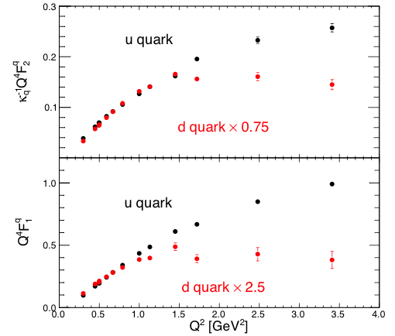
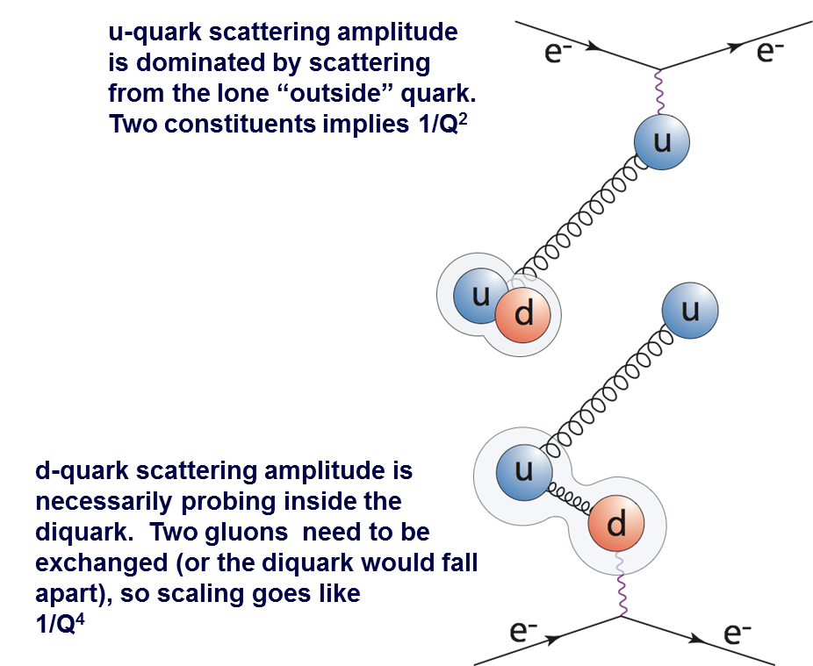
Gs≈0 So Do a Flavor Separation of the Form Factors
We see very different behavior for the
up and down quarks!
F_{d} seems to scale like 1/Q⁴ whereas
F_{u} seems to scale more like 1/Q²
in proton
Why is the d-quark so much wider?
Cates, de Jager, Riordan, and Wojtsekhowski,
PRLvol. 106, 252003 (2010)
Does the di-quark explain the scaling?

Slide 17
Polarized Beam Capabilities
(as reported at PAC16, 6/99)
Date | Experiment | Source Performance
3/97 | Hall A FPP test | ~35% | 10 μA
7/97 | 1st physics - Hall A FPP | ~35% | ~30 μA
12/97 | HAPPEX test run | ~35% | ~30 μA | Parity
4/98 | HAPPEX 1st Run (& g1) | ~39% | >100 μA | Parity
5/98 | G_{E}^{p} | ~41% | >120 μA
8/98 | G_{E}^{n} (& eg1) | >70% | ~200 nA
9/98 | GDH evolution (&eg1) | >70% | 13 μA
2/99 | G_{M}^{n} (& e1) | ~75% | ~25 μA
3/99 | High P for HAPPEX & e1, w/ high current unpolarized for Hall C | ~75% | 30-40 μA* & 100 μA | Parity
Goal |  | >80% | 200 μA | Parity
* Test runs of up to 90μA, high polarization

Slide 18
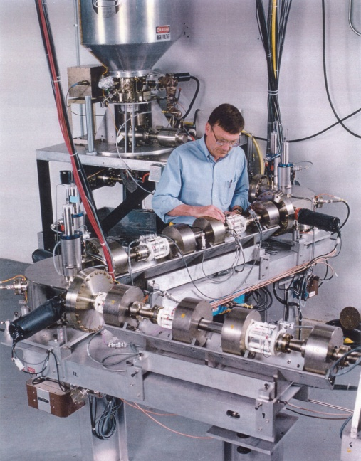
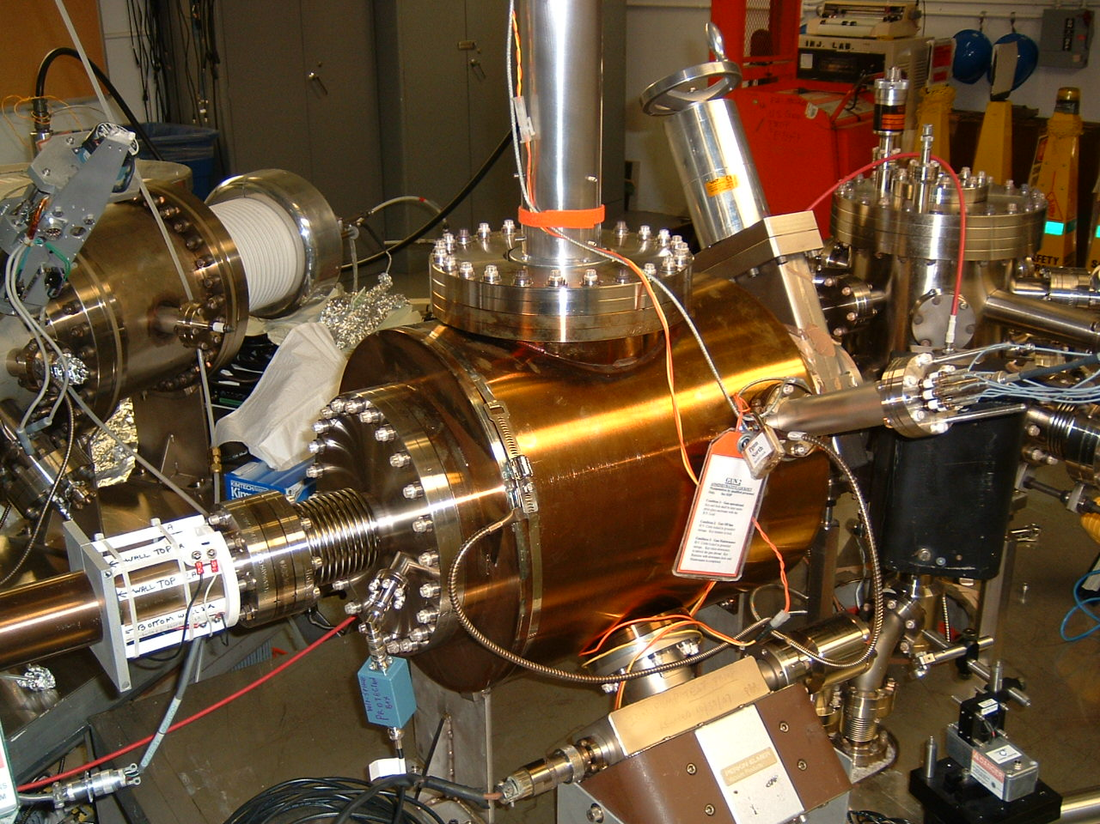
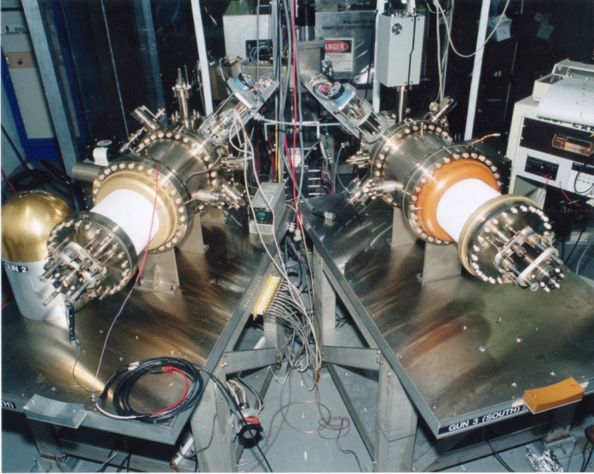
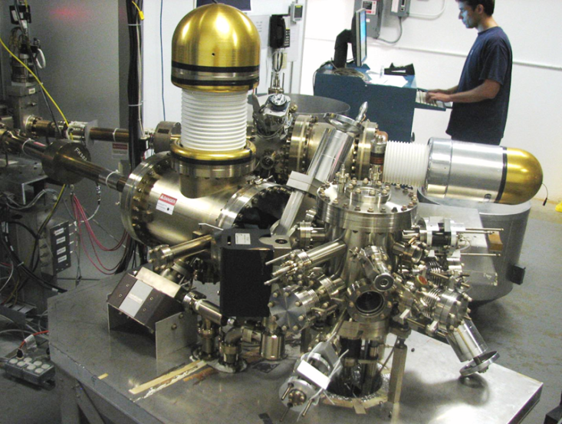
Always Tweaking the Design
1
4
Endless (?) quest for perfection
2
3

Slide 19
Parity Violation Experiments at CEBAF
Experiment | Energy (GeV) | I (µA) | Target | A_{pv} (ppb) | Maximum Charge Asym (ppb) | Maximum Position Diff (nm) | Maximum Angle Diff (nrad) | Maximum Size Diff (δσ/σ)
HAPPEx-II (Achieved) | 3.0 | 55 | ¹H (20 cm) | 1400 | 400 | 1 | 0.2 | Was not specified
HAPPEx-III (Achieved) | 3.484 | 100 | ¹H (25 cm) | 16900 | 200±100 | 3±3 | 0.5±0.1 | 10⁻³
PREx | 1.063 | 70 | ²⁰⁸Pb (0.5 mm) | 500 | 100±10 | 2±1 | 0.3±0.1 | 10⁻⁴
QWeak | 1.162 | 180 | ¹H (35 cm) | 234 | 100±10 | 2±1 | 30±3 | 10⁻⁴
Møller | 11.0 | 75 | ¹H (150 cm) | 35.6 | 10±10 | 0.5±0.5 | 0.05±0.05 | 10⁻⁴
Today
Coming
PV experiments motivate polarized e-source R&D

Slide 20
Charged Pion Electromagnetic Form Factor
Where does the dynamics of the q-q interaction make a transition from
the strong (confinement) to the perturbative (QED-like) QCD regime?
Pre-JLab data from
pion scattering
from atomic electrons
Initial F_{π}(Q²) from
πe elastic scattering
Notes:
It will occur earliest in the simplest systems
→ the pion form factor F_{π}(Q²) provides our best chance to
determine the relevant distance scale experimentally

Slide 21
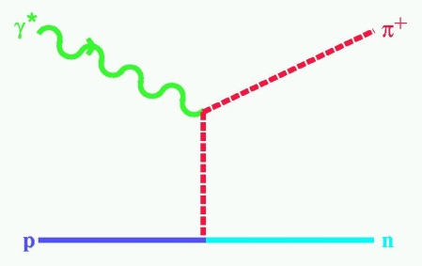
Charged Pion Electromagnetic Form Factor
Where does the dynamics of the q-q interaction make a transition from
the strong (confinement) to the perturbative (QED-like) QCD regime?
To extend F_{π}(Q²) :
At low Q² (< 0.3 (GeV/c)²): use p + e
scattering → R_{rms} = 0.66 fm
At higher Q²: use ¹H(e,e’p⁺)n,
measure σ_{L}
“Extrapolate” σ_{L} to t = +m_{π}² using a realistic pion electroproduction (Regge-type) model to extract F_{π}
t = (p_{π}-q)² < 0
F_{π}(Q²) Today
Notes:
It will occur earliest in the simplest systems
→ the pion form factor F_{π}(Q²) provides our best chance to
determine the relevant distance scale experimentally

Slide 22
Charged Pion Form Factor – 12 GeV
Further extend F_{π}(Q²)
w/ 12 GeV
Measure F_{π} up to 6 (GeV/c)² to probe onset of pQCD
π⁺/π⁻ measurements to test t-channel dominance of σ_{L}
Q² = 0.30 (GeV/c)² close to pion pole to compare to π+e elastic
F_{π}(Q²) 12 GeV Plans

Slide 23
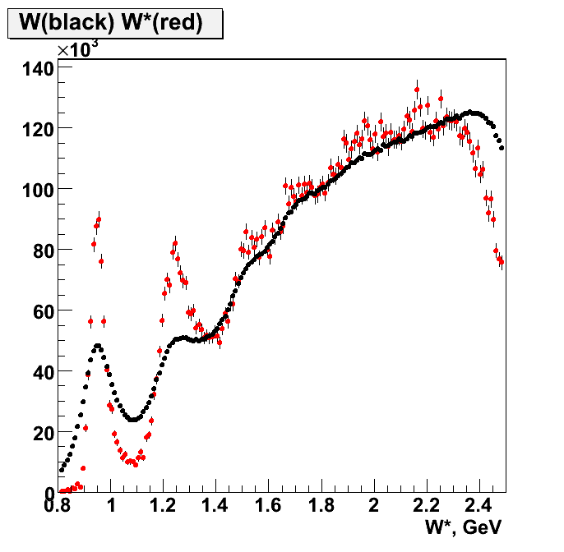
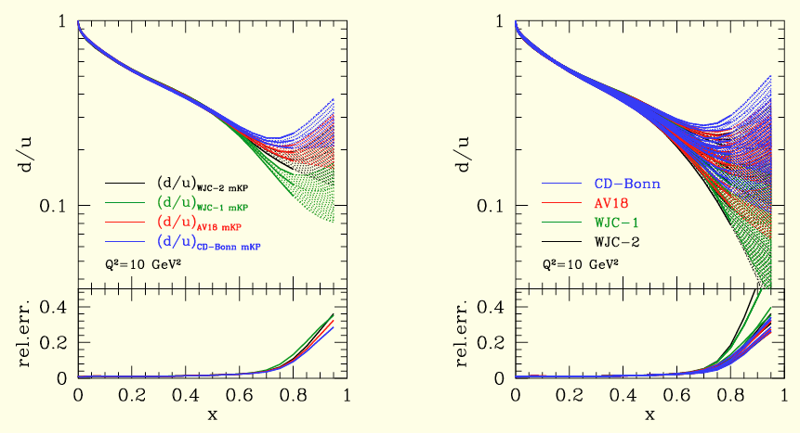
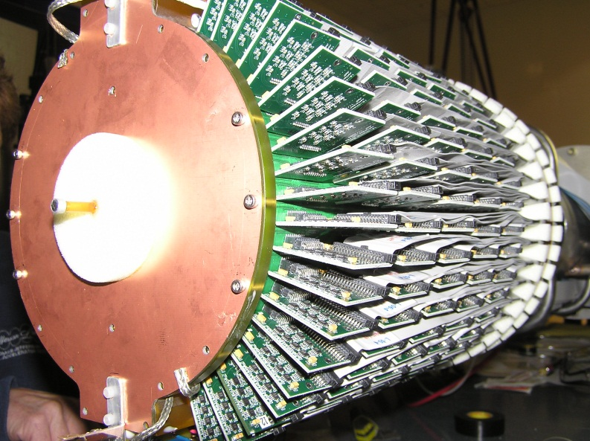
BoNuS Experiment w/ CLAS
CTEQ-JLab Fits of world data.
No free neutron target; complications using deuterium
The solution? Tag the spectator proton
6 mm diameter target

Slide 24
BoNuS Experiment w/ CLAS
CTEQ-JLab Fits of world data.
No free neutron target; complications using deuterium
Contributions from:
Beam Energy
Major Ancillary Equipment
(Innovative Target/Detector Design)
CLAS Detectors
Cross-Hall Cooperation
The solution? Tag the spectator proton
6 mm diameter target

Slide 25



Laying the Groundwork for a Deeper Understanding Nucleon Structure:
From Form Factors and PDFs to Generalized Parton Distributions (GPDs)
Elastic Scattering & Form Factors:
Transverse charge & current densities in coordinate space
DIS & Structure
Functions:
Quark longitudinal
& helicity distributions
in momentum space
DES & GPDs:
Correlated quark distributions
In transverse coordinate
and longitudinal momentum
space

Slide 26
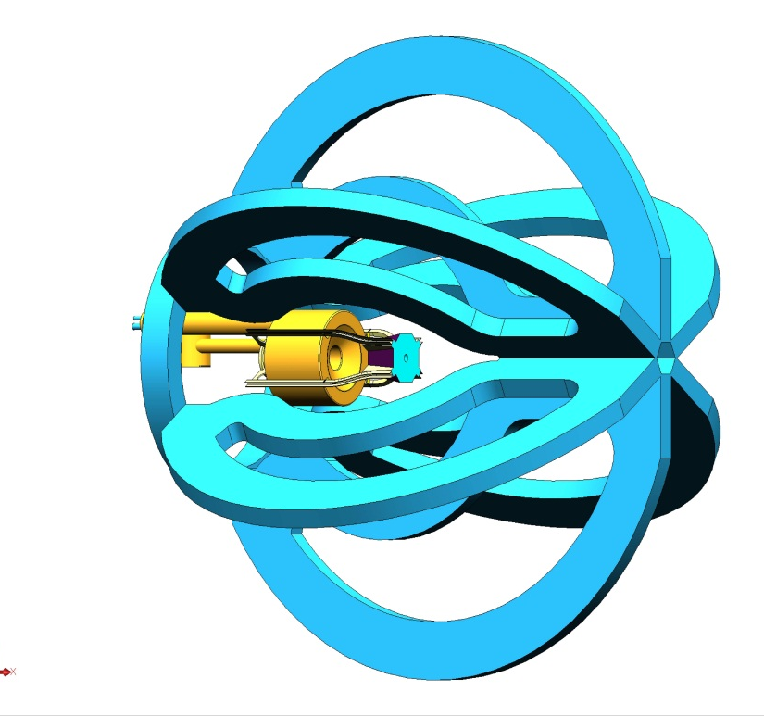
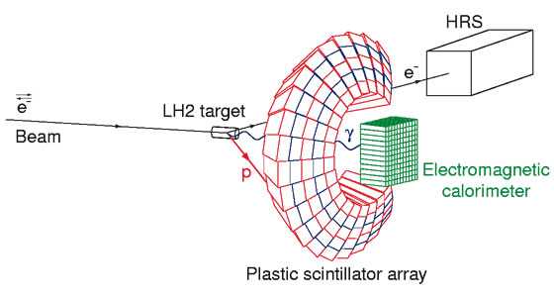
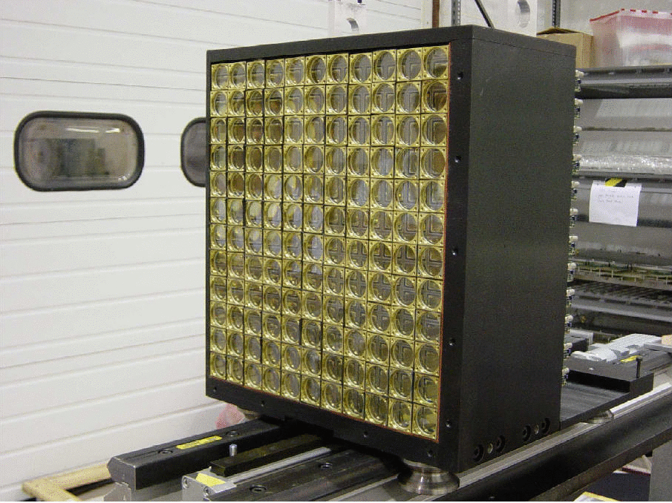
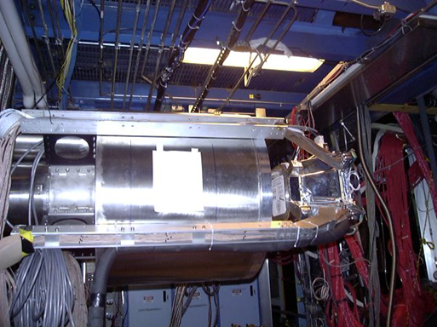
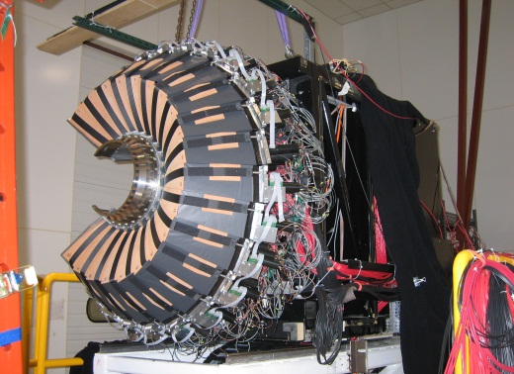
GPD Experiments in CLAS & Hall A

Slide 27
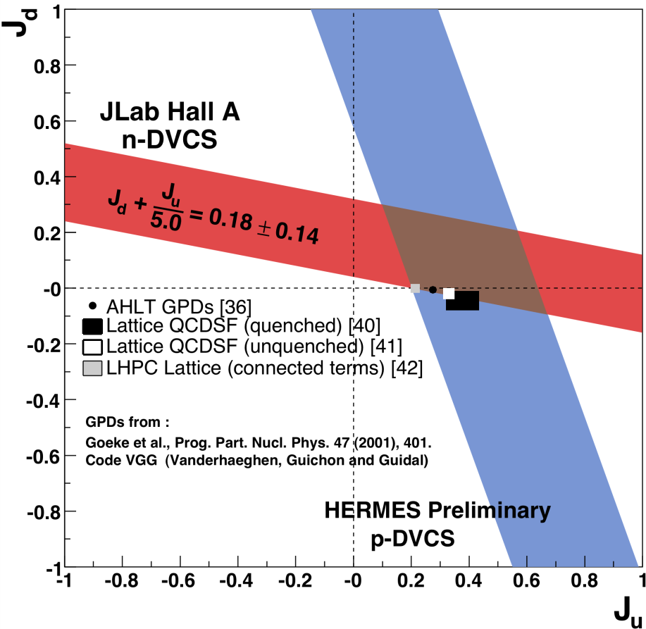
GPD Experiments in CLAS & Hall A
Contributions from:
Beam Energy and Quality
Innovative Target/Detector Design
Major New Ancillary Equipment
Strong Expt./Theory Collaboration

Slide 28
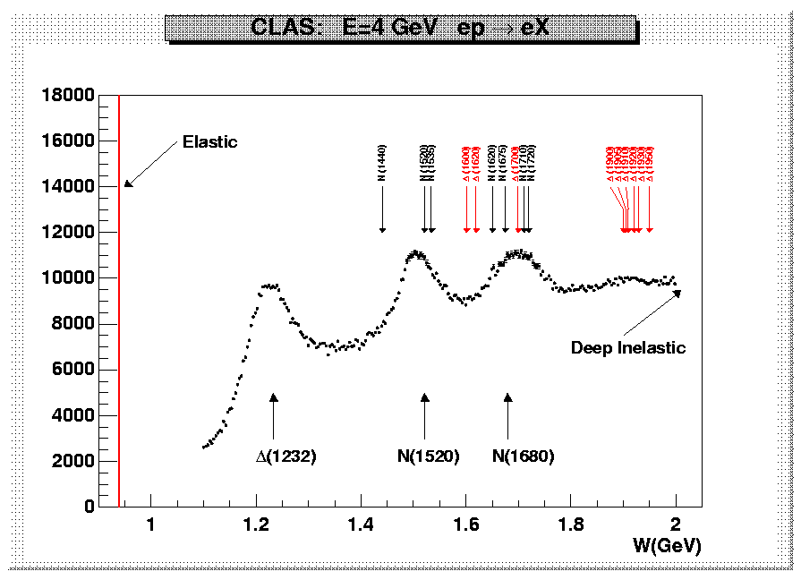
N* physics w/ (e,e’) is Tough: e p → e’ X at 4 GeV
events
CLAS

Slide 29
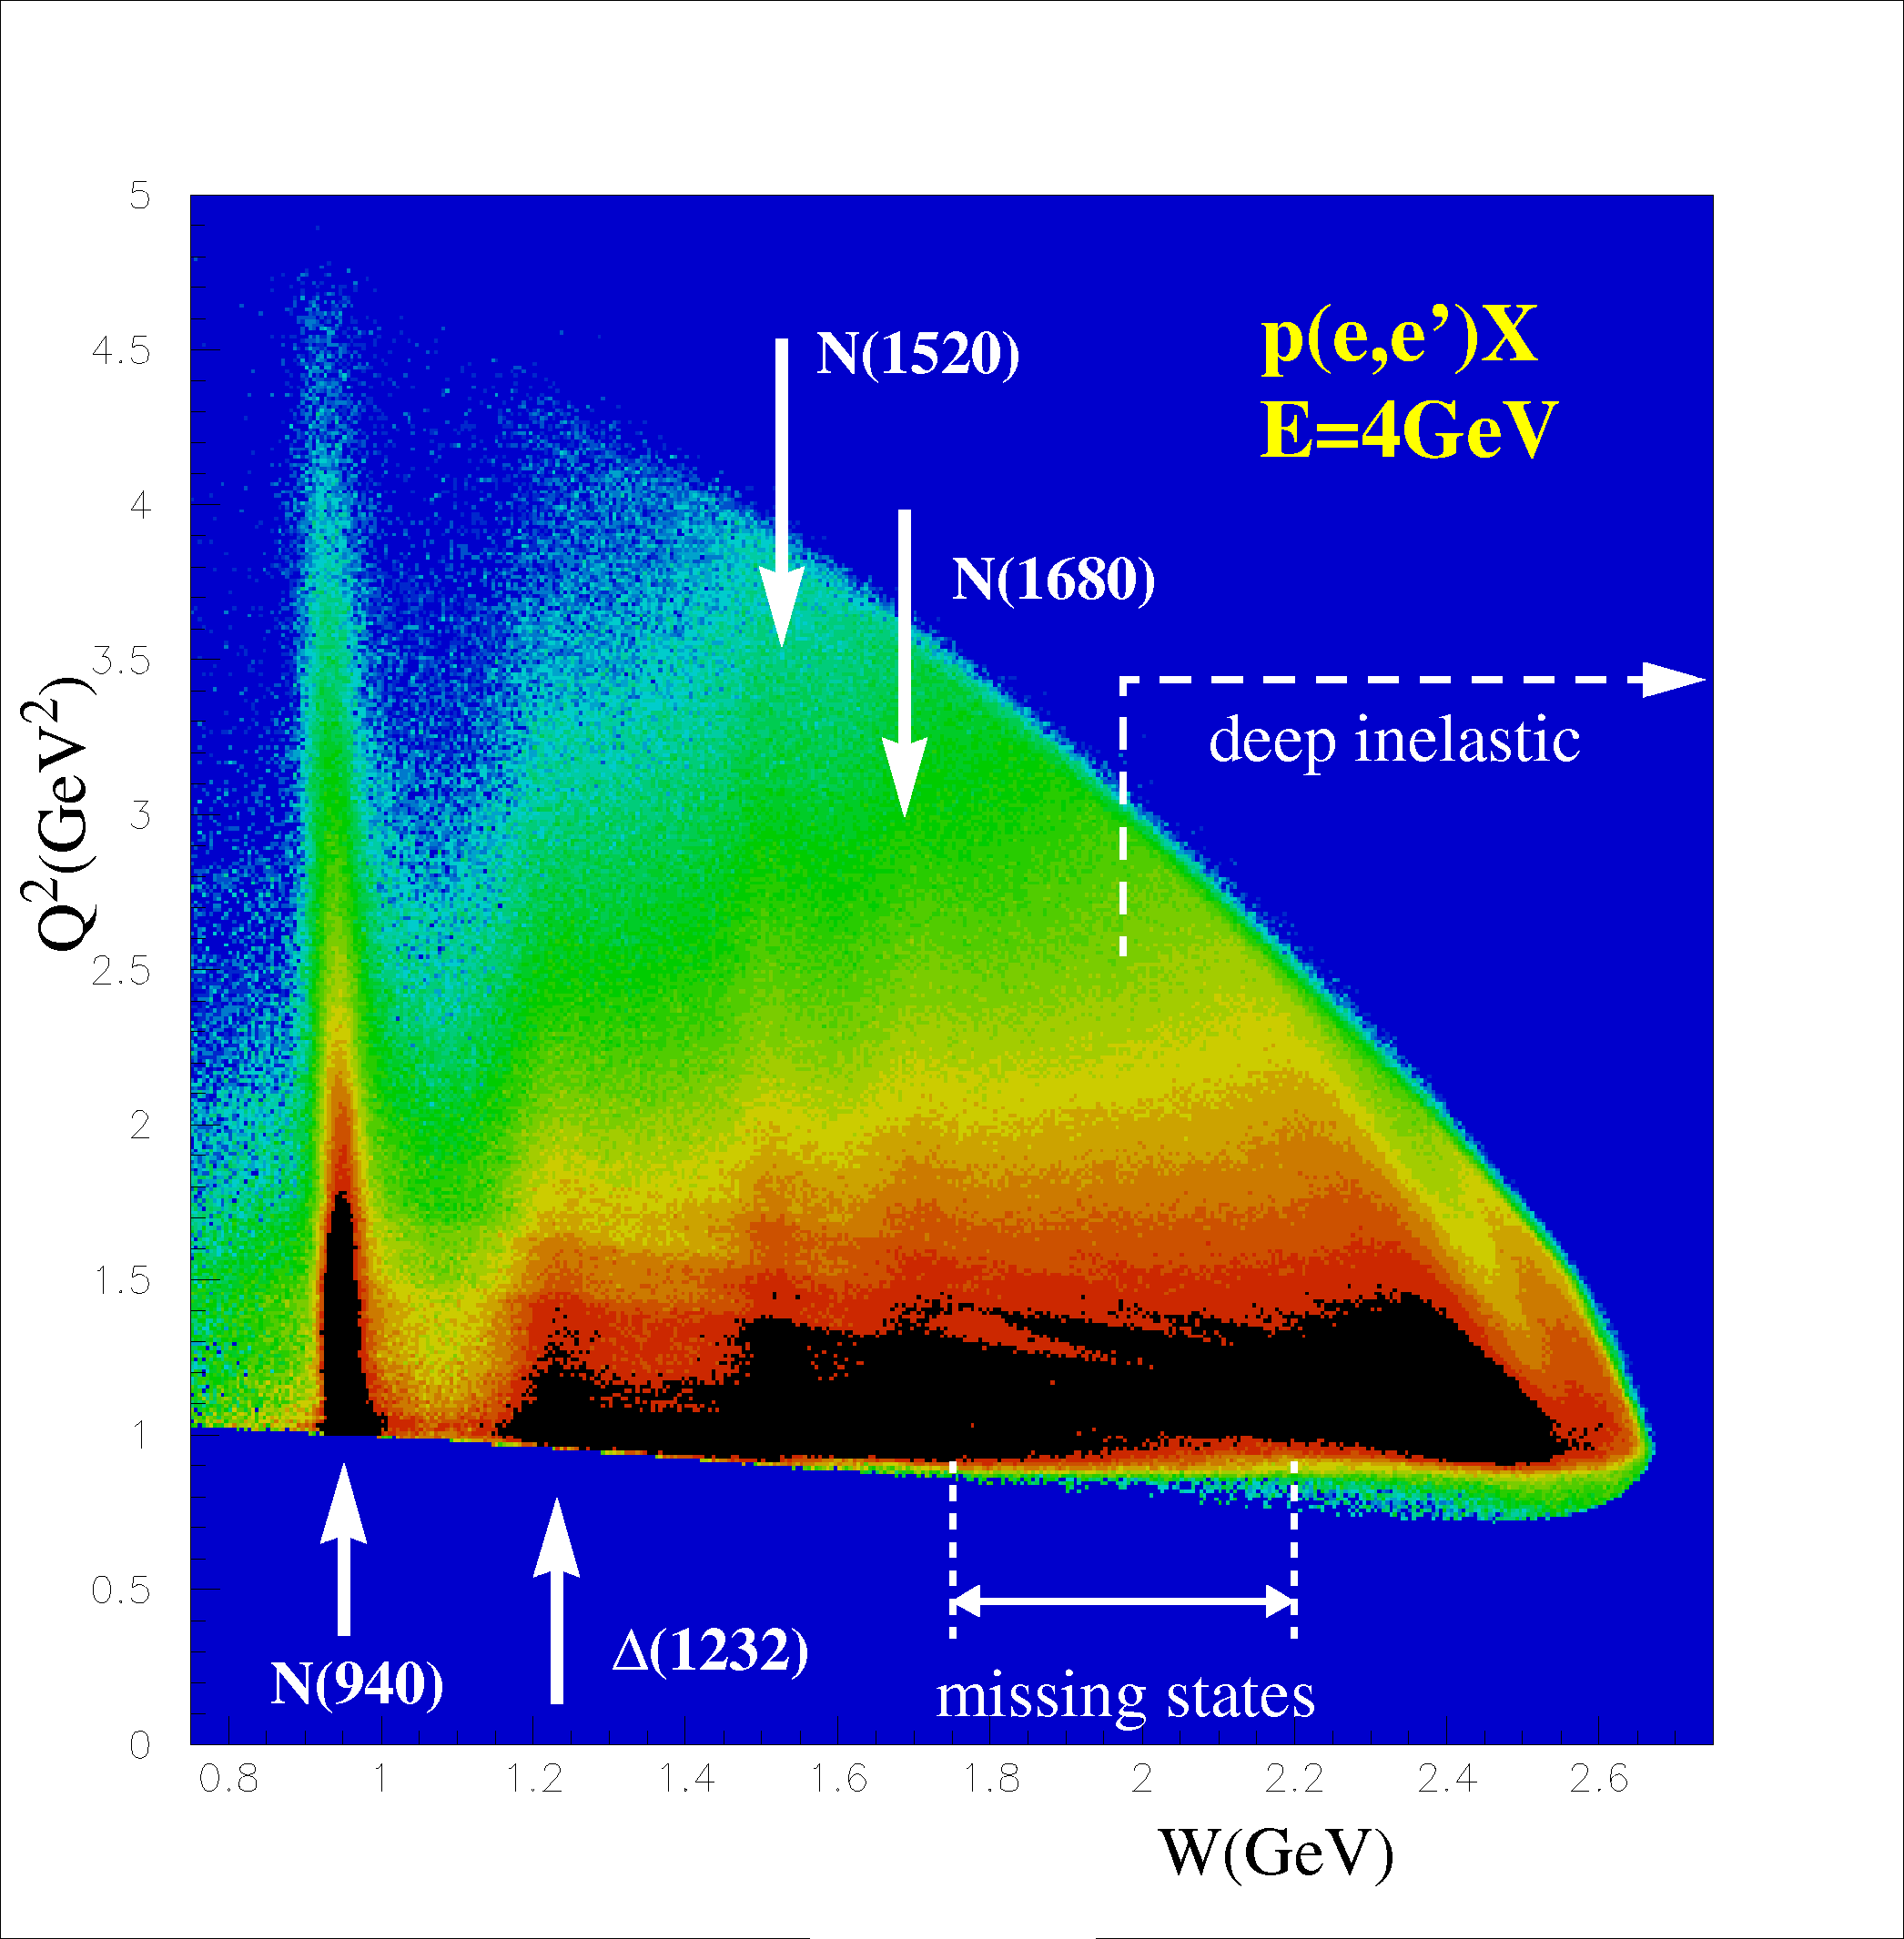
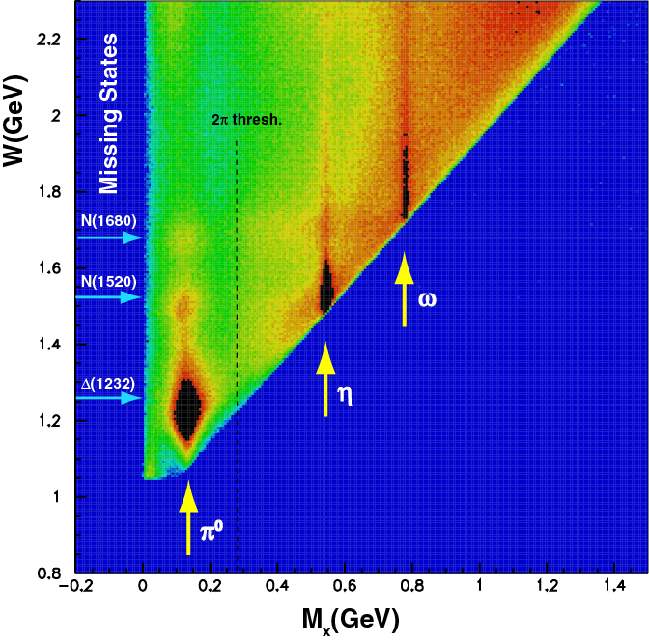
CLAS Measures: a Broad Range of Q² and W Simultaneously, and Excited State Decay
CLAS Coverage for E = 4 GeV
e p → e’ X
e p → e′ p X
5
4
3
2
1
0
1
1.5
2
2.5
Notes:
CLAS measures a broad range of Q**2 and W simultaneously (left figure)
And
CLAS can simultaneously (via coincidence) see decay of state excited at known W
Note, for example, missing stat region has omega decay – not seen (not surprisingly) in pion excitation

Slide 30
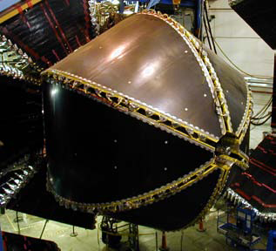
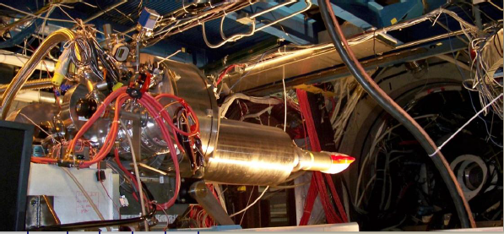
Status of Single Meson Production on Protons & Neutrons
✔ - published ✔ - acquired ✔ - HDIce
Final 6 GeV N* run w/ HDIce target just completed
 | σ | Σ | T | P | E | F | G | H | T_{x} | T_{z} | L_{x} | L_{z} | O_{x} | O_{z} | C_{x} | C_{z}
pπ⁰ | ✔ | ✓ | ✓ |  | ✓ | ✓ | ✓ | ✓
nπ⁺ | ✔ | ✓ | ✓ |  | ✓ | ✓ | ✓ | ✓
pη | ✔ | ✓ | ✓ |  | ✓ | ✓ | ✓ | ✓
pη’ | ✔ | ✓ | ✓ |  | ✓ | ✓ | ✓ | ✓
pω | ✔ | ✓ | ✓ |  | ✓ | ✓ | ✓ | ✓
K⁺Λ | ✔ | ✓ | ✓ | ✔ | ✓ | ✓ | ✓ | ✓ | ✓ | ✓ | ✓ | ✓ | ✓ | ✓ | ✔ | ✔
K⁺Σ⁰ | ✔ | ✓ | ✓ | ✔ | ✓ | ✓ | ✓ | ✓ | ✓ | ✓ | ✓ | ✓ | ✓ | ✓ | ✔ | ✔
K^{0*}Σ⁺ | ✔ | ✓ |  |  |  |  |  |  |  |  | ✓ | ✓
pπ⁻ | ✔ | ✓ | ✓ |  | ✓ | ✓ | ✓ | ✓
pρ⁻ | ✓ | ✓ | ✓ |  | ✓ | ✓ | ✓ | ✓
K⁻Σ⁺ | ✓ | ✓ | ✓ |  | ✓ | ✓ | ✓ | ✓
K⁰Λ | ✓ | ✓ | ✓ | ✓ | ✓ | ✓ | ✓ | ✓ | ✓ | ✓ | ✓ | ✓ | ✓ | ✓ | ✓ | ✓
K⁰Σ⁰ | ✓ | ✓ | ✓ | ✓ | ✓ | ✓ | ✓ | ✓ | ✓ | ✓ | ✓ | ✓ | ✓ | ✓ | ✓ | ✓
K^{0*}Σ⁰ | ✓ | ✓
Proton targets
Data taking completed
with g9b-FROST
Neutron targets
Just completed
with G14-HD run

Slide 31
CLAS impact on N* states in PDG 2012
Results based on Bonn-Gatchina coupled-channel analysis
State N((mass)J^{P} | Status PDG 2010 | Status PDG 2012 | KΛ 2012 | KΣ 2012 | Nγ 2012
N(1710)1/2⁺ | *** not seen in GW analysis | *** | *** | ** | ***
N(1880)1/2⁺ |  | ** | ** | * | **
N(1895)1/2⁻ |  | ** | ** | * | ***
N(1900)3/2⁺ | ** | *** | *** | ** | ***
N(1875)3/2⁻ |  | *** | *** | ** | ***
N(2150)3/2⁻ |  | ** | ** |  | **
N(2000)5/2⁺ | * | *** | ** | * | **
N(2060)5/2⁻ |  | *** |  | ** | ***
Contributions from:
Beam Energy
Polarized Electrons
Accelerator Beam Quality
Innovative Target Designs
CLAS Detector
Combined Theory/Experiment
Analysis Effort
Contributions from:
You get the idea – no more
details from this point on

Slide 32
Transition Form Factors are Elucidating Nucleon Structure
(e,e’) to the Roper saw “through” the pion cloud to the CQM core,
explaining a long-standing mystery
CLAS data: I.G. Aznauryan et al., Phys.Rev.C80:055203,2009
JLab data
The first radial excitation in a covariant valence quark-diquark model reproduces the data at Q²>1.5GeV² well (solid line). The difference to the data shown as open squares represents meson cloud contributions (blue symbols) which dominate F₂ at low Q².
G. Ramalho and K. Tsushima, Phys.Rev.D81, 074020 (2010)

Slide 33
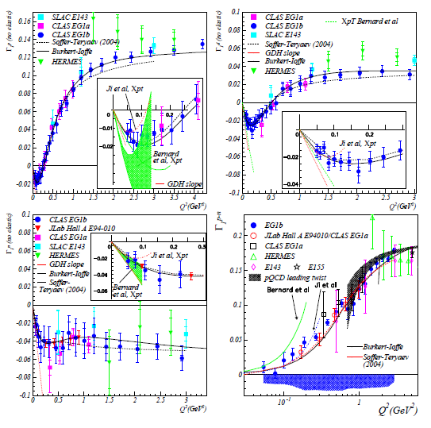
Γ₁(Q²) for p, n, d, and (p-n) Demonstrates the Evolution of QCD w/ Distance
proton
deuteron
neutron
proton
- neutron

Slide 34
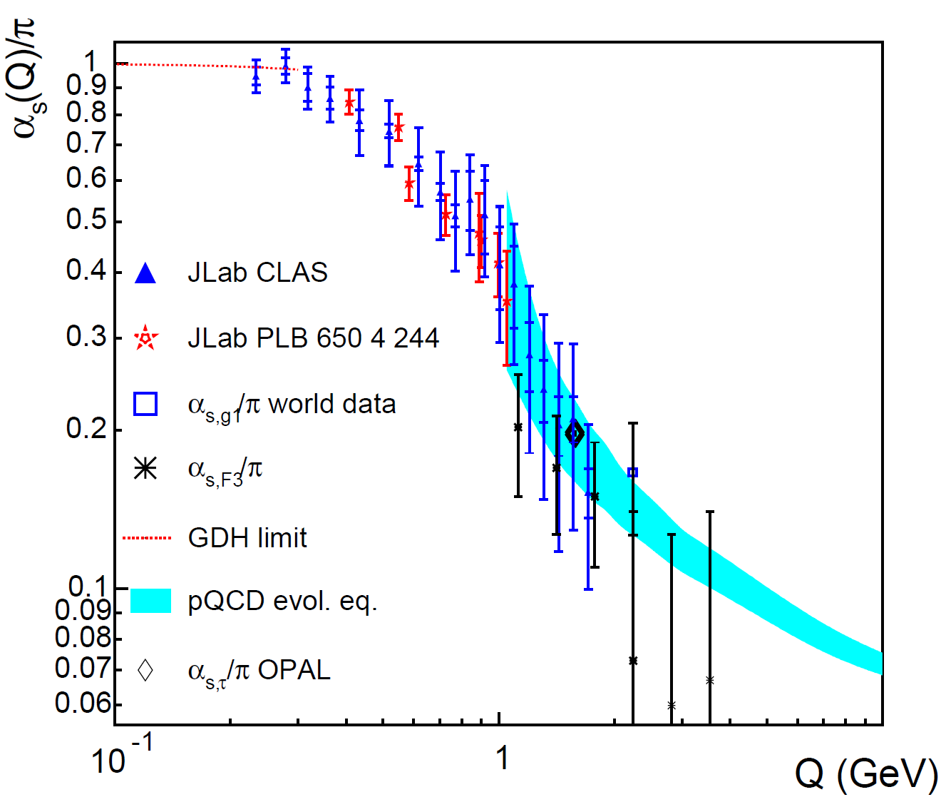
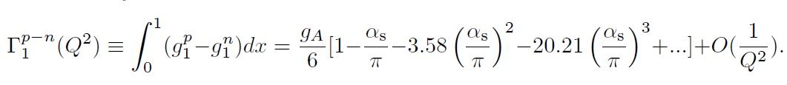
And Γ₁^{p-n} Together with the Bjorken Sum Rule Lets us Extract a Value for α_{s}^{eff}/π

Slide 35
So Looking Back at the past 30 Years:
How Well Have We Succeeded In Realizing Those Initial Science Goals?
Review them by broad physics topic:
  QCD and the Structure of Hadrons
  Nuclei: From Structure to Exploding Stars
  In Search of the New Standard Model
  Given the time, only a few examples in each area are possible – I’ve picked ones I particularly liked, with an emphasis on experiments that were made feasible by the unique capabilities of the accelerator and its experimental equipment

Slide 36
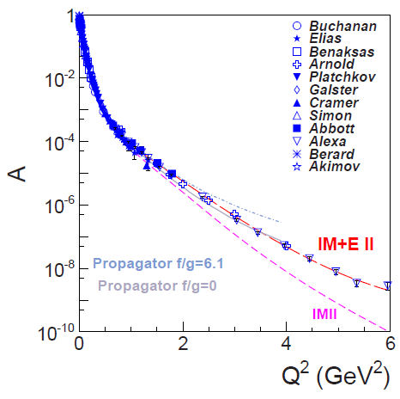
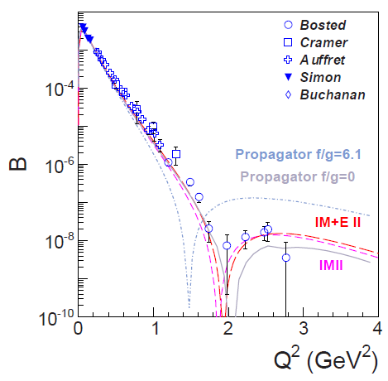
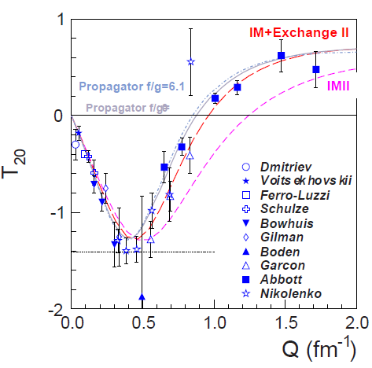
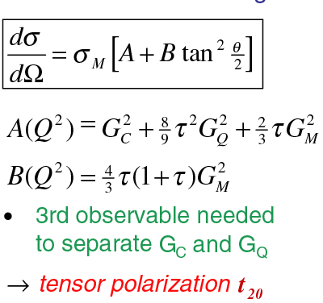
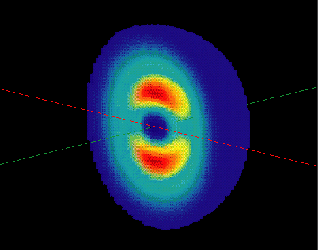
An Early Result: eD Elastic Scattering
Calculations by Phillips, Wallace,
and Devine, and by Huang and
Polyzou describe the data to
Q² ~2 (GeV/c)² (i.e. describe
the deuteron to distance scales
of ~0.5 fm)
Combined data ⇒ Deuteron’s
Intrinsic Shape

Slide 37
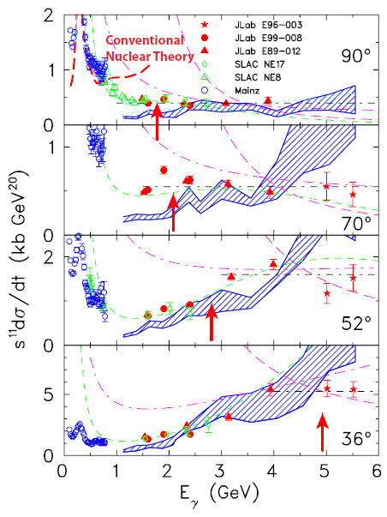
JLab d(γ,p) Data Identified the Transition to the Quark-Gluon Description
Deuteron Photodisintegration probes momenta well beyond those accessible in (e,e’)
(at 90º, E_{γ}=1 GeV ⇔ Q²= 4 GeV²/c²)
Conventional nuclear theory unable to reproduce the data above ~1 GeV
Scaling behavior (dσ/dt ∝ s⁻¹¹) sets in at a consistent t = − 1.37 (GeV/c)² (see ↑ )
⇒ seeing underlying quark-gluon description for scales below ~0.1 fm
dσ/dt ~ f(θ_{cm})/s^{n-2}
Where n=n_{A} + n_{B} + n_{C} + n_{D}
s=(p_{A}+p_{B})², t=(p_{A}-p_{C})²
γd → pn ⇔ n=13
p_{A}
p_{C}
p_{B}
p_{D}
Confirmed in follow-on
experiment w/ CLAS that
studied the transition region
in more detail

Slide 38
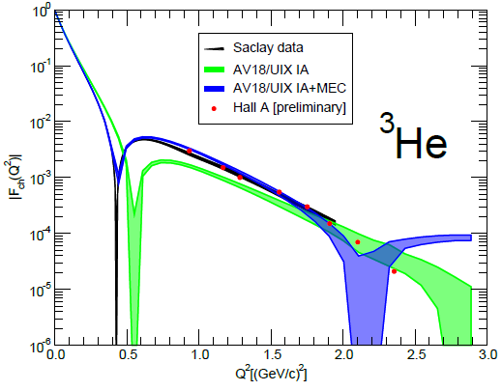
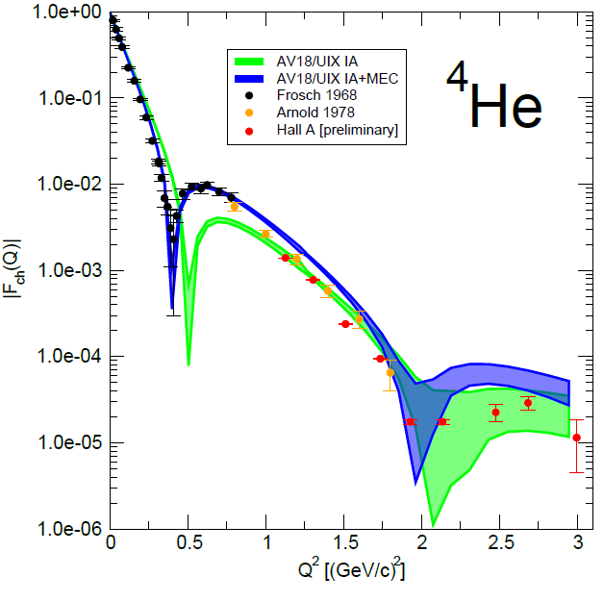
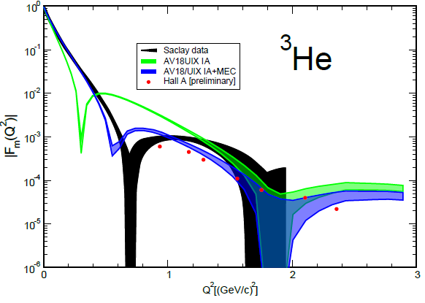
Data Now Includes 3- and 4-Body Elastic Scattering
Calculations by Marcucci, Viviani, and Schiavilla w/ MEC give a good description of the charge form factor data to 2 (GeV/c)² (i.e. to distance scales of ~0.5 fm), but fail sooner for the ³He magnetic form factor
Possible evidence for problems with the exchange currents, relativity, 3-body forces, …….?

Slide 39
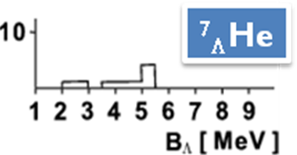
An example of what we learn from Hypernuclei
A Highlight of JLab E01-011 (HKS)
The First reliable observation of ⁷_{Λ}He
Old result on ⁷_{Λ}He
(M.Juric et al. NP B52 (1973) 1)
Inadequate for a serious comparison
A Test of Charge Symmetry Breaking
Begin with a theoretical description of these nuclei without CSB
A Naïve calculation of the CSB effect, which explains ⁴_{Λ}H –⁴_{Λ}He and available s, p-shell hypernuclear data, predicts opposite shifts for A=7 ,T=1 iso-triplet Λ Hypernuclei.

Slide 40
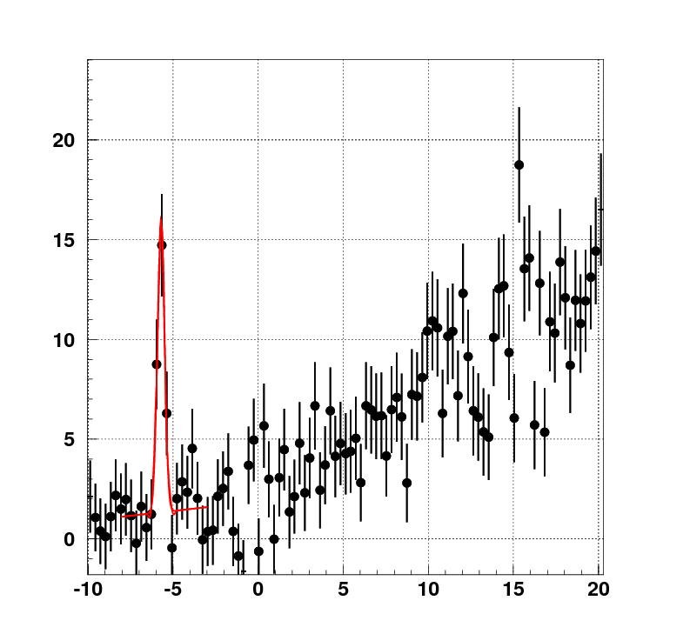
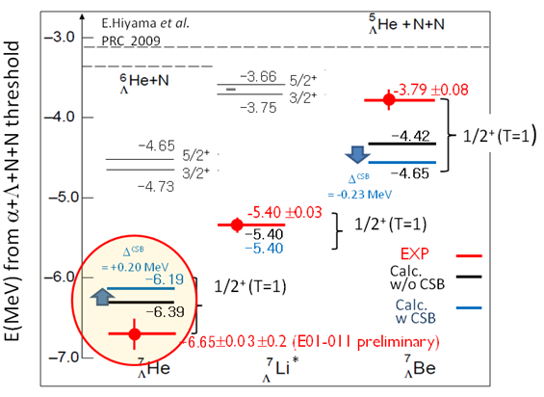
An example of what we learn from Hypernuclei
A Highlight of JLab E01-011 (HKS)
B_{Λ} = 5.68 ±0.03 ±0.22 MeV
The First reliable observation of ⁷_{Λ}He
-6.65±0.03 ±0.22 MeV
from α Λ n n
A Test of Charge Symmetry Breaking
Compare with new measurements of ⁷_{Λ}He
Measured shift opposite the predicted shift!
Need to add Λ-N, and Σ-N Coupling?
⁷Li(e,e’K⁺)⁷_{Λ}He
-B_{Λ} (MeV)
Begin with a theoretical description of these nuclei without CSB
A Naïve calculation of the CSB effect, which explains ⁴_{Λ}H –⁴_{Λ}He and available s, p-shell hypernuclear data, predicts opposite shifts for A=7 ,T=1 iso-triplet Λ Hypernuclei.

Slide 41

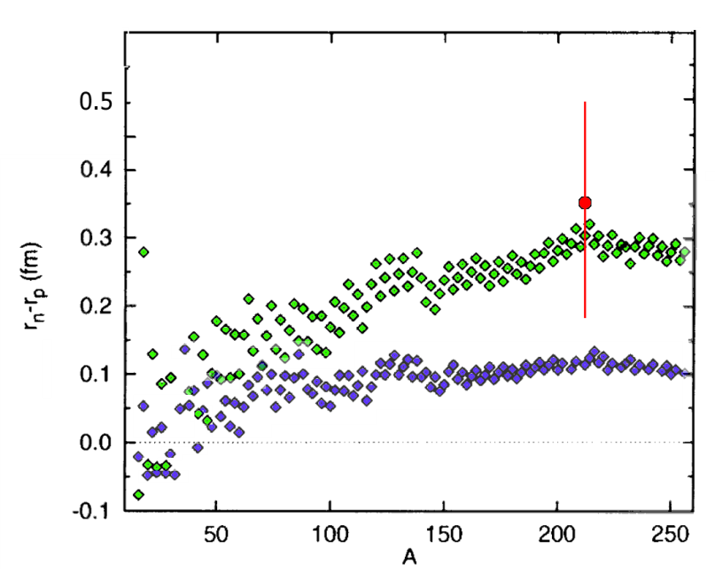
Lead (²⁰⁸Pb) Radius Experiment : PREX
Elastic Scattering Parity-Violating Asymmetry
Z⁰ : Clean Probe Couples Mainly to Neutrons
Applications : Nuclear Physics, Neutron Stars,
Atomic Parity, Heavy Ion Collisions
PREX
Anticipated error bar
(12 GeV experiment)
PREX
Relativistic mean field
Nonrelativistic skyrme
A neutron skin of 0.2 fm or more has implications for our understanding of neutron stars and their ultimate fate
The Lead (²⁰⁸Pb) Radius Experiment (PREX) finds neutron radius larger than proton radius by +0.35 fm (+0.15, -0.17).
This result provides model-independent confirmation of the existence of a neutron skin relevant for neutron star calculations.
Follow-up experiment to reduce uncertainties by factor of 3 and pin down symmetry energy in EOS.

Slide 42
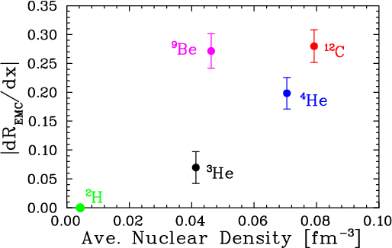
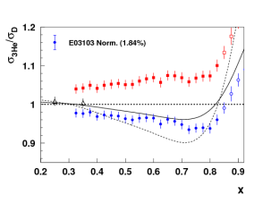
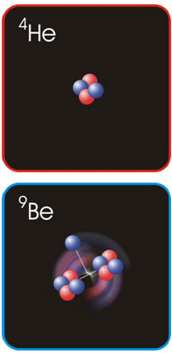
New JLab Data on the EMC Effect in Very Light Nuclei
EMC effect scales with average nuclear density if we ignore Be
?
Be = 2 α clusters (⁴He nuclei) + “extra” neutron
Suggests EMC effect depends on local nuclear environment
dR/dx = slope of line fit to A/D ratio over region x=0.3 to 0.7
Nuclear density extracted from ab initio GFMC calculation – scaled by (A-1)/A to remove contribution to density from “struck” nucleon
C. Seely, A. Daniel, et al, PRL 103, 202301 (2009)

Slide 43
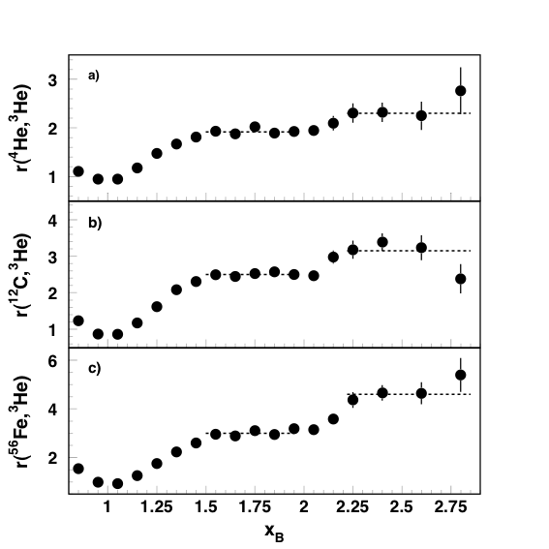
Extend DIS from Quarks in Nuclei to x_{B}>1 to Access Short Range Correlations
and
then
r(A,³He) = a_{2n}(A)/a_{2n}(³He)
a_{2n} 2N-probability above k_{Fermi}
The observed scaling means that the electrons probe the high-momentum nucleons in the 2N-SRC phase, and the scaling factors determine the per-nucleon probability of the 2N-SRC phase in nuclei with A>3 relative to ³He
Analysis shows that 3-N SRC
are 10 times smaller than 2-N SRC.
K. Sh. Egiyan et al., PRC 68 (2003) 014313; PRL 96 (2006) 082501
At any moment, the number of 2-nucleon SRC
are 0.3, 1.2 and 6.7 in ⁴He, ¹²C and ⁵⁶Fe, respectively
Originally done with SLAC data
by D.B. Day et al., PRL 59 (1987) 427

Slide 44
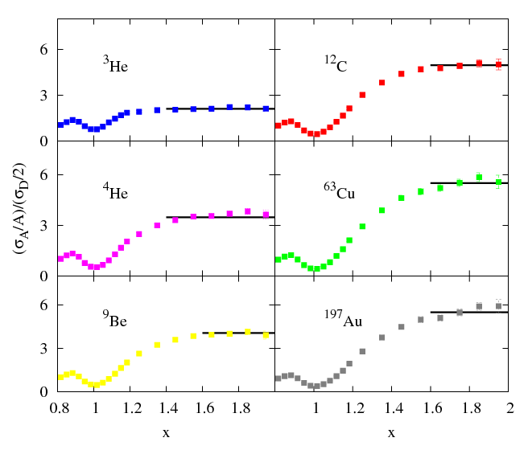
Higher Precision, Higher Q² Follow-on Experiment
E02-019: 2N correlations in A/D ratios
18° data
<Q²>=2.72GeV²
R(A, D)
w/ further effort (E08-014) in x>2 region
to resolve apparent differences
³He | 2.14(4) | 1.93(10)
⁴He | 3.66(7) | 3.02(17)
Be | 4.00(8) | 3.37(17)
C | 4.88(10) | 4.00(24)
Cu | 5.37(11) | 4.33(28)
Au | 5.34(11) | 4.26(29)
Correct for inelastics and high p_{M} tail due to pair motion to get relative 2N-SRC contribution . Ratios are in excellent agreement with CLAS results for 2N correlations
Raw cross
section ratio
N. Fomin, et al, Phys. Rev. Lett. 108, 092502 (2012)

Slide 45
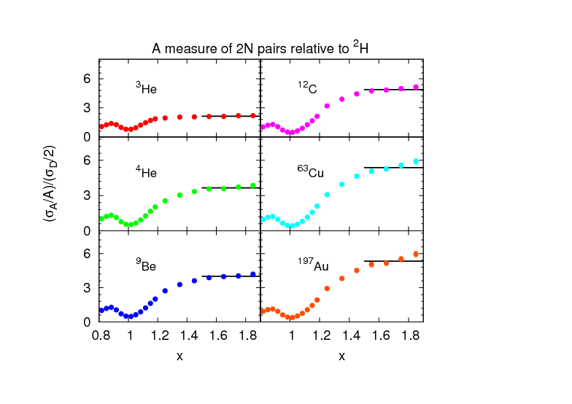
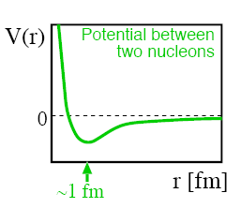
Short-Range Correlations (SRC) and European Muon Collaboration (EMC) Effect Are Correlated
EMC Slopes
0.35 ≤ X_{B} ≤ 0.7
Fomin et al, PRL 108, 092502 (2012)
SRC Scaling factors X_{B} ≥ 1.4
SRC: nucleons see strong repulsive core at short distances
EMC effect: quark momentum in nucleus is altered
Weinstein et al, PRL 106, 052301 (2011)

Slide 46
So Looking Back at the past 30 Years:
How Well Have We Succeeded In Realizing Those Initial Science Goals?
Review them by broad physics topic:
  QCD and the Structure of Hadrons
  Nuclei: From Structure to Exploding Stars
  In Search of the New Standard Model
  Given the time, only a few examples in each area are possible – I’ve picked ones I particularly liked, with an emphasis on experiments that were made feasible by the unique capabilities of the accelerator and its experimental equipment

Slide 47
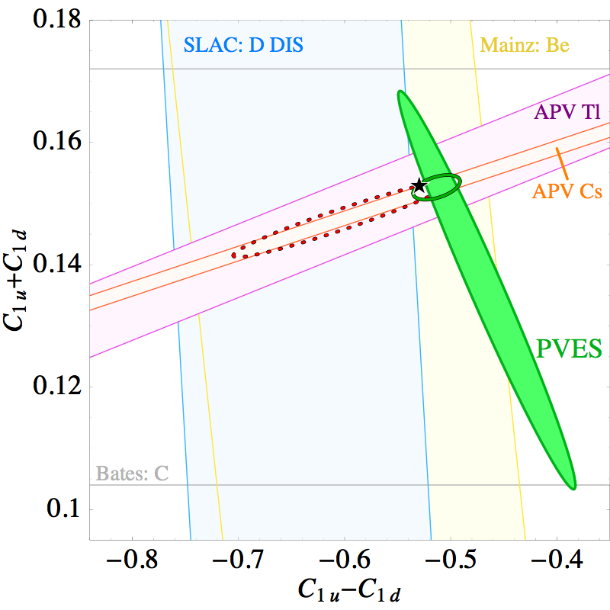
The Strange Quark Experiments Have Impact Beyond
Our Understanding of Nucleon Structure:
e.g. for C1q couplings in the Standard Model
R. Young, R. Carlini,
A. Thomas & J. Roche,
PRL 99, 122003 (2007)
All Data & Fits
Plotted at 1 σ
A dramatic
improvement in our knowledge of
weak couplings!
Factor of 5 increase
in precision of
Standard Model test
HAPPEx: H, He
G⁰: H,
PVA4: H
SAMPLE: H, D

Slide 48

Q_{Weak} will further test our understanding of the
C1q couplings in the Standard Model
R. Young, R. Carlini,
A. Thomas & J. Roche,
PRL 99, 122003 (2007)
Isoscalar weak charge
All Data & Fits
Plotted at 1 σ
Qweak (now nearing
Completion) will
provide ANOTHER
Factor of 5 increase
in precision of
Standard Model test
HAPPEx: H, He
G⁰: H,
PVA4: H
SAMPLE: H, D
Isovector weak charge

Slide 49


PrimEx
Precision Measurement of π⁰ Lifetime
Chiral anomaly of QCD predicts exact value of decay width.
γ
π⁰
E02-103, E08-023
Primakoff effect
Γ(π⁰→γγ) = 7.82eV±0.14±0.17
(2008)
(2002)
Projected uncertainty for PrimEx-II (E08-023) – data taken in Fall 2010.
E02-103
PrimEx I
I. Larin et al., Phys. Rev. Lett. 106: 162303 (2011).

Slide 50
Q_{Weak} Will Also Determine the Weak Charge of the Proton and Test the Running of Sin²θ_{W}
Data in hand, and Accuracy
expected to be achieved
MS Theory Curve : J. Erler,
M. J. Ramsey-Musolf et al.,
See Particle Data Group 2010

Slide 51
Further Precision Tests of Electro-Weak Theory
Are Planned for 12 GeV
MS Theory Curve : J. Erler,
M. J. Ramsey-Musolf et al.,
See Particle Data Group 2010

Slide 52
So How Well Have We Succeeded In Realizing Those Initial Science Goals Set by the Barnes Panel?
Single nucleon structure
Deuteron and few body form factors and inelastic processes
Production of vector mesons and baryons
Discrete states and giant resonances in complex nuclei
Δ and N* production in nuclei
Single nucleon hole states in complex nuclei
Hypernuclei
Deep inelastic scattering on complex nuclei
Fundamental symmetries

Slide 53
So How Well Have We Succeeded In Realizing Those Initial Science Goals Set by the Barnes Panel?
Single nucleon structure
Deuteron and few body form factors and inelastic processes
Production of vector mesons and baryons
Discrete states and giant resonances in complex nuclei
Δ and N* production in nuclei
Single nucleon hole states in complex nuclei
Hypernuclei
Deep inelastic scattering on complex nuclei
Fundamental symmetries
⎫
⎫
⎫
0
⎫
⎫
⎫
⎫
⎫
⎫
But the job hasn’t been completed!
We have a treasure trove of data, and
must take seriously the job of completing
its analysis and interpretation so we have
advanced our science to the maximum
extent possible.

Slide 54
So What Lessons Can We Take from This Experience?
Carefully work through what is needed to carry out the identifiable essential science before you start building
  Flexibility matters, as you cannot predict where the science will take you!
  This was done in planning for 12 GeV (we’ll see if we got it right)
  It is in process now for a future EIC – don’t stint on the effort
Stand up for what we believe is essential for our science and be prepared to explain it fully to your colleagues in nuclear physics, to the larger science community, and to the public
Remember that a fully engaged, first rate User Community has been essential to our success; strive to make this a place they WANT to come to do their science.

Slide 55
So What Lessons Can We Take from This Experience?
Appreciate and acknowledge the support we have received from DOE, NSF, International funding agencies, etc……..
Treasure our graduate students and postdocs, and train them well
Appreciate the many contributions of the folks building and running the accelerator and mounting experiments in the halls – they will help you achieve your goals and work to help you
exceed them
Maintain a strong PAC and theory group, and listen to what they tell you

Slide 56






Coming Next: The JLab 12 GeV Upgrade
Major Programs in Six Areas
The End
(which is, of course, the beginning of
12 GeV and beyond)
The Hadron spectra as probes of QCD
(GluEx and heavy baryon and meson spectroscopy)
The transverse structure of the hadrons
(Elastic and transition Form Factors)
The longitudinal structure of the hadrons
(Unpolarized and polarized parton distribution functions)
The 3D structure of the hadrons
(Generalized Parton Distributions and Transverse Momentum Distributions)
Hadrons and cold nuclear matter
(Medium modification of the nucleons, quark hadronization, N-N correlations, hypernuclear spectroscopy, few-body experiments)
Low-energy tests of the Standard Model and Fundamental Symmetries
(Møller, PVDIS, PRIMEX, …..)
And other science
we can’t foresee

Slide 57
Coming Next: The JLab 12 GeV Upgrade
Major Programs in Six Areas
The Hadron spectra as probes of QCD
(GluEx and heavy baryon and meson spectroscopy)
The transverse structure of the hadrons
(Elastic and transition Form Factors)
The longitudinal structure of the hadrons
(Unpolarized and polarized parton distribution functions)
The 3D structure of the hadrons
(Generalized Parton Distributions and Transverse Momentum Distributions)
Hadrons and cold nuclear matter
(Medium modification of the nucleons, quark hadronization, N-N correlations, hypernuclear spectroscopy, few-body experiments)
Low-energy tests of the Standard Model and Fundamental Symmetries
(Møller, PVDIS, PRIMEX, …..)
And other science
we can’t foresee

